Slide 1
REDOX AIRLINES
MATTHIAS ONIDOMA

Slide 2
INTRODUCTION
Redox Airline is an aviation business that operates within United States of America. The management of the Airline has strong airline operation background but little or no financial or data analytics experience.
Due to the inefficiencies associated with the Disparate data system they operate on, the CEO requested that I analyze their data within 2014-2015 and give insights to drive business growth in the aviation industry.

Slide 3
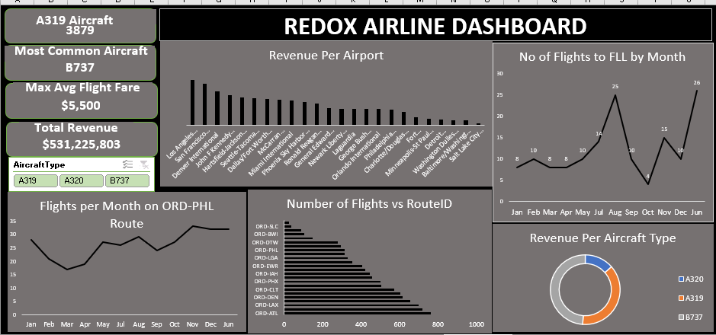

Slide 4
KEY PERFORMANCE INDICATORS
Total Revenue(Dollars)-$531,225,803
Most Common Aircraft- B737
Maximum AVG Flight Fare across all Aircraft - $5,500
Total Flights that used A319 Aircraft- 3879

Slide 5
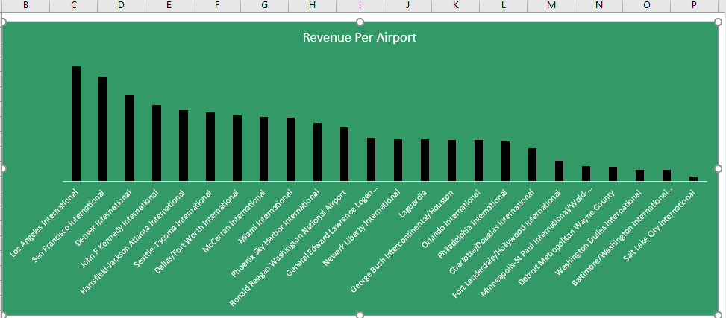
INSIGHTS
REVENUE PER AIRPORT
Los Angeles generated the highest Revenue
Salt Lake City generated the lowest Revenue

Slide 6
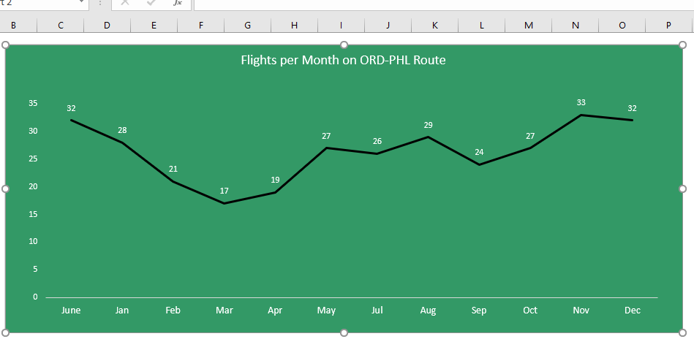
FLIGHTS PER MONTH ON ORD-PHL ROUTE
November recorded the Highest number of Flights
March recorded the lowest number of Flights

Slide 7
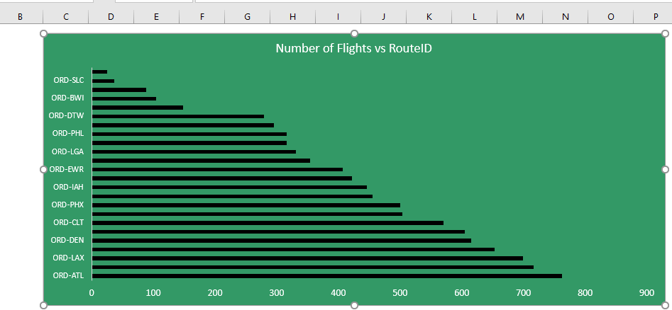
Number of Flights per Route ID
Route ORD-ATL recorded the Highest number of Flights
Route ORD-DCA recorded the lowest number of Flights

Slide 8
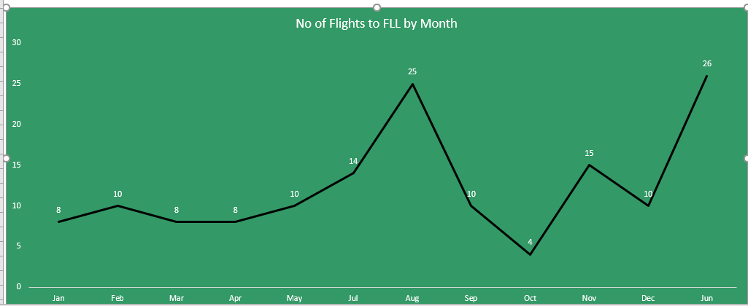
Number of Flights to FLL(by month)
June recorded the Highest number of Flights
October recorded the lowest number of Flights

Slide 9
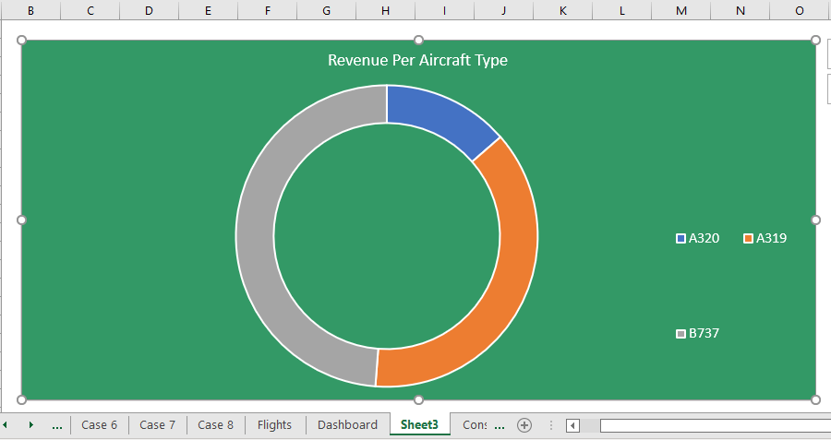
Revenue per Aircraft Type
Aircraft B737 recorded the Highest number of Revenue
Aircraft A320 recorded the lowest number of Revenue

Slide 10
RECOMMENDATIONS
Since Disparate data system is inefficient, Redox Airline should migrate to a Homogenous system for their data storage.
Aircraft B737 should be considered as priority during procurement, owing to the fact that the revenue it generated is about 49% of the entire revenue(more efficient than the other aircraft, low maintenance cost, lesser wear and tear)
Redox Airline should study what San Francisco and Los Angeles International Airport have in common, that made them generate very high Revenue(as seen in Revenue per Airport Chart).
Departure delays should be eliminated to improve efficiency and enhance competitiveness in the aviation sector.

Slide 11
LIMITATIONS
Data relating to maintenance of the Aircraft should be made available for subsequent Analysis
Data around the operation cost including the emolument for Pilots, Air hostesses should be provided for further analysis

